Slide 1
Applied Software Security
Lecture 1

Slide 2
The basics - (Part 1)
Low level - assembly and the machine.
Computer Systems. A Programmer’s Perspective [3rd ed.].
Low Level Programming C, Assembly and Program Execution on Intel 64 Architecture.
Computer Architecture A Quantitative Approach (5th edition).
Reverse engineering.
Reversing: Secrets of Reverse Engineering.
Practical Reverse Engineering.
Modern Operating Systems.
We will extensively reference these books throughout the first part of the course,

Slide 3
Assembly and the machine
A machine:
We want a machine that computes things: 3+5, 35462346254524*99750706363, x(n)=1/(1+1/n), etc.
For those interested in some theoretical background (will not occupy us): Random Access Machine, Harvard / Von-Neumann / modified architectures.
https://www.microcontrollertips.com/difference-between-von-neumann-and-harvard-architectures/

Slide 4
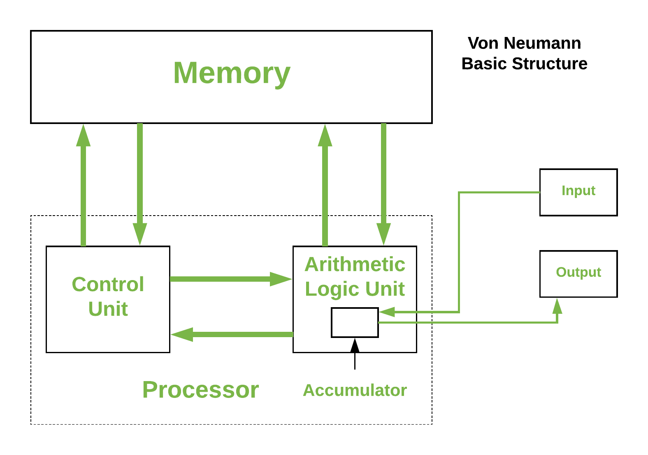
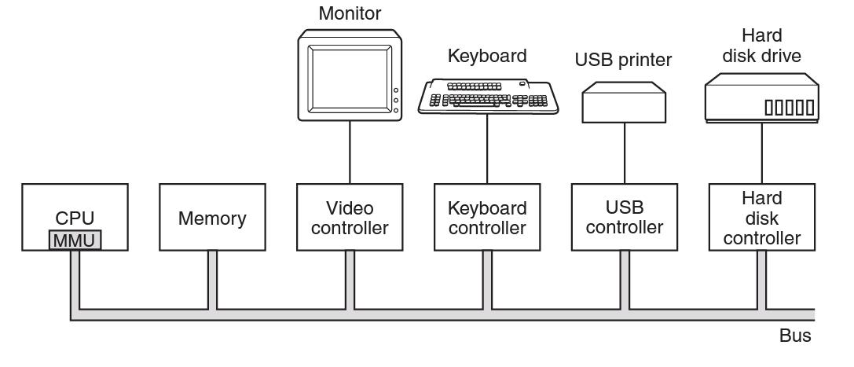
Modern Machines
Basic overview (“Von-Neumann”):
https://www.geeksforgeeks.org/computer-organization-von-neumann-architecture/

Slide 5
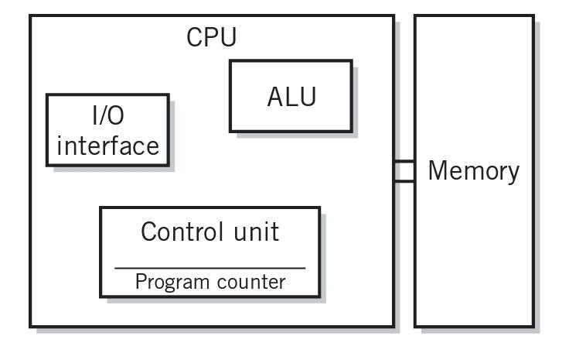
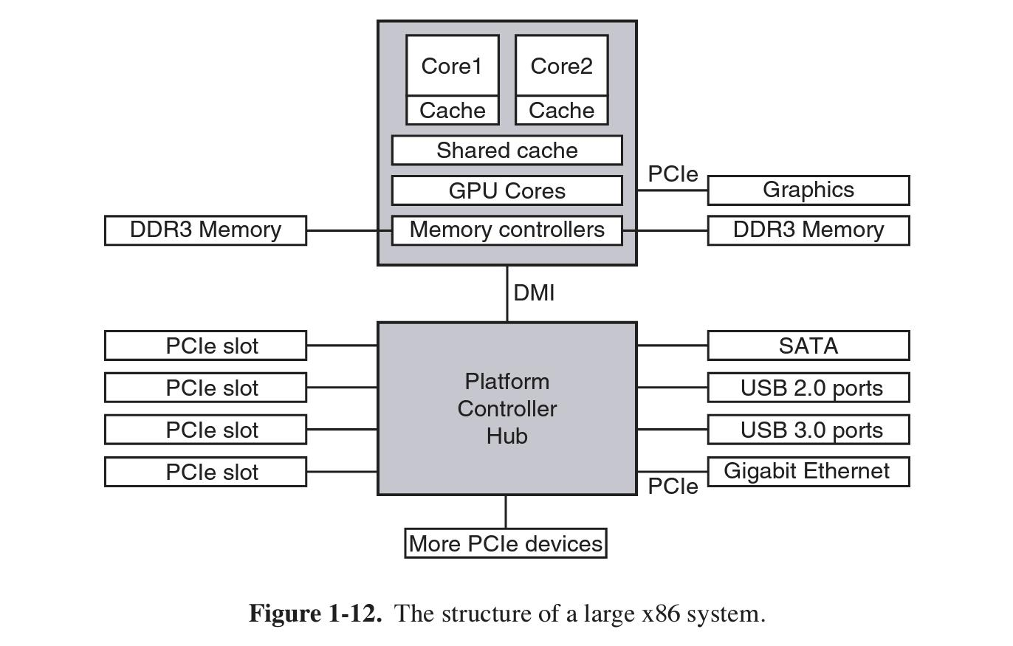
For our intents and purposes
A bit more detailed:

Slide 6
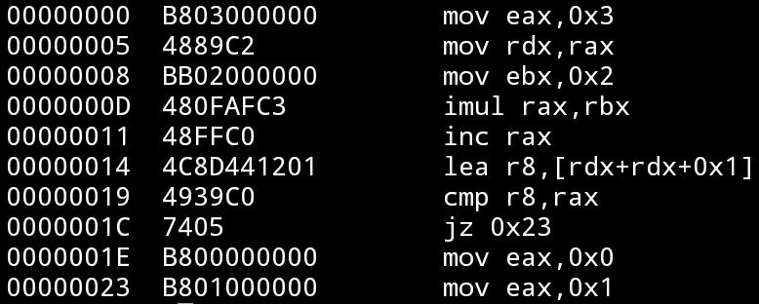
So what can a modern machine do?
Each machine (architecture) supports a set of instructions (operations), which it is able to execute, referred to as its instruction set.
The instructions are encoded in manner which the specific machine understands. The encoded instructions are often referred to as opcodes.
An assembly language for a machine is a programming language, which contains a (more or less) 1-1 representation of the machine operations in human readable symbols. It usually contains some basic features desired when programming for a machine.
Many different architectures exist, with many instruction sets.
http://en.wikipedia.org/wiki/List_of_instruction_sets
There are some very common ones: x86, ARM, (mips, sparc…), and many share a lot in design and concepts.

Slide 7
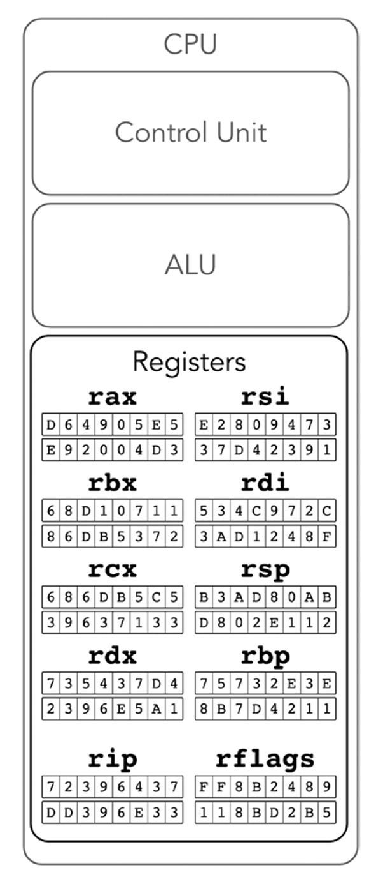
The x86-64 architecture - an overview
The model (similar among a lot of register based machines):
Registers: Basic storage units, of fixed size: machine word size (8 bytes = 64 bits in x86-64). Reside on the cpu, are accessed fast, and are the basic operands of instructions. There are general purpose registers for general operations, and some with a special usage.
Memory: A larger storage unit, divided into cells, each identified with an address, and can contain 256 values (1 byte) which can be written to and read from. The operand of some instructions. Access to the memory is slower.

Slide 8
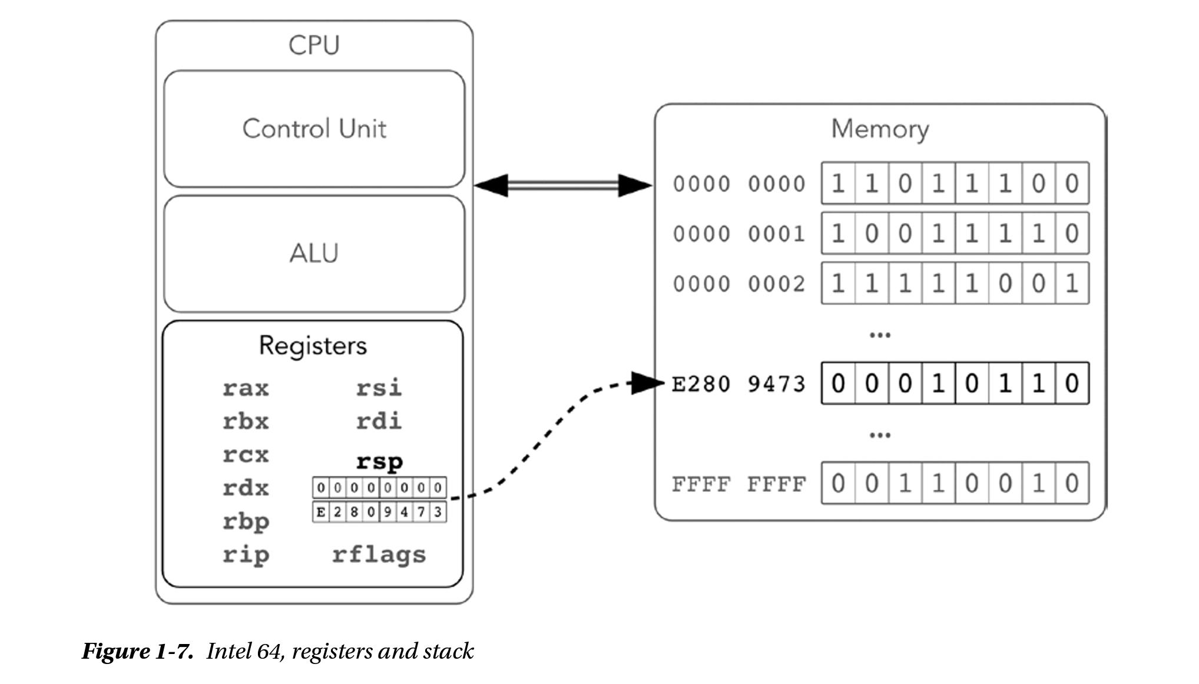

Slide 9
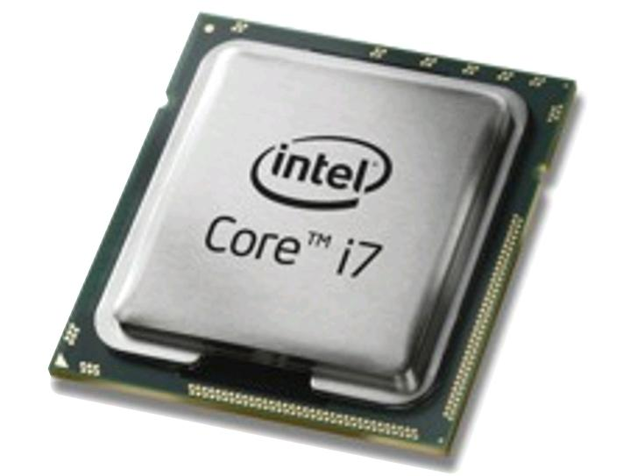

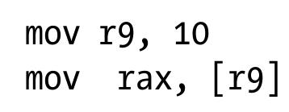
How are instructions executed?
The cpu (central processing unit, or processor) is the main execution engine of the machine.
It iteratively fetches instructions stored in the main memory (aka RAM), and executes them. Different instructions preform different operations on the memory and registers (such as load, store, arithmetic operations).

Slide 10
The cpu contains a special register called the program counter (pc, in x86-64 referred to as rip), which contains the address in the memory of the next instruction to be executed.
The program counter is updated every time an instruction is fetched and executed by the cpu.*
addr data decoded instr
*The process is a bit more complex then that, we will get to it when we talk about the execution pipeline.

Slide 11
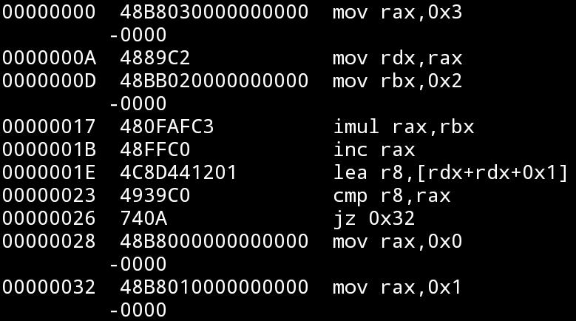
Q: How will the machine state look when this code is executed?
A: (partial) register state:
rip = 0, rax = ?, rbx = ?, rdx = ?, r8 = ? =>
rip = 0x0a, rax = 0x03, rbx = ?, rdx = ?, r8 = ? =>
rip = 0x0d, rax = 0x03, rbx = ?, rdx = 0x03, r8 = ? =>
rip = 0x17, rax = 0x03, rbx = 0x02, rdx = 0x03, r8 = ? =>
rip = 0x1b, rax = 0x06, rbx = 0x02, rdx = 0x03, r8 = ? =>
rip = 0x1e, rax = 0x07, rbx = 0x02, rdx = 0x03, r8 = ? =>
rip = 0x23, rax = 0x07, rbx = 0x02, rdx = 0x03, r8 = 0x07 =>
rip = 0x26, rax = 0x07, rbx = 0x02, rdx = 0x03, r8 = 0x07, rflags(!): …. ZF=1 =>

Slide 12
End of overview, now the details.
Note: In the lectures we will talk about x86-64 (64 bit), but most of what we say (with an exception of the parts related specifically to the difference between 64 and 32 bit machines) is applicable for x86 (32 bit), usually replacing r with e (i.e. rax => eax)

Slide 13
Data representations in the memory (skip if known):
Data representations:
We will represent data almost always in hexadecimal basis (prefixed with 0x, and digits 0,1,....,9,a,b,....,f). Sometimes in binary representation (prefixed with 0b, and digits 0,1)
In machines data is usually represented in a basis which is a power of 2 (this is a consequence of the physical implementation of machine components, in particular as the data is represented using physical cells which can hold 2 distinguishable values (“bit”: 0,1).
The data in x86-64 is stored using little endian (le) convention (as opposed to big endian convention), in which a number is stored in the memory with the least significant bit/byte/word/digit first (and ordered by significance - least significant substorage unit in a storage unit would be with the lowest address). That is the number 1193046 = 0x123456, stored at address 0x100 in the memory as a 4 byte word,would look as follows:
memory
address: 0xff 0x100 0x101 0x102 0x103 0x104
bytes: ?? 0x56 0x34 0x12 0x00 ??
in bits: ?? 01101010 (theoretically, practically bits do not have an address)
(note 0x56 = 0b01010110 = 0*(2⁰)+1*2¹+1*2²+0*2³+1*2⁴+0*2⁵ +1*2⁶+0*2⁷)

Slide 14
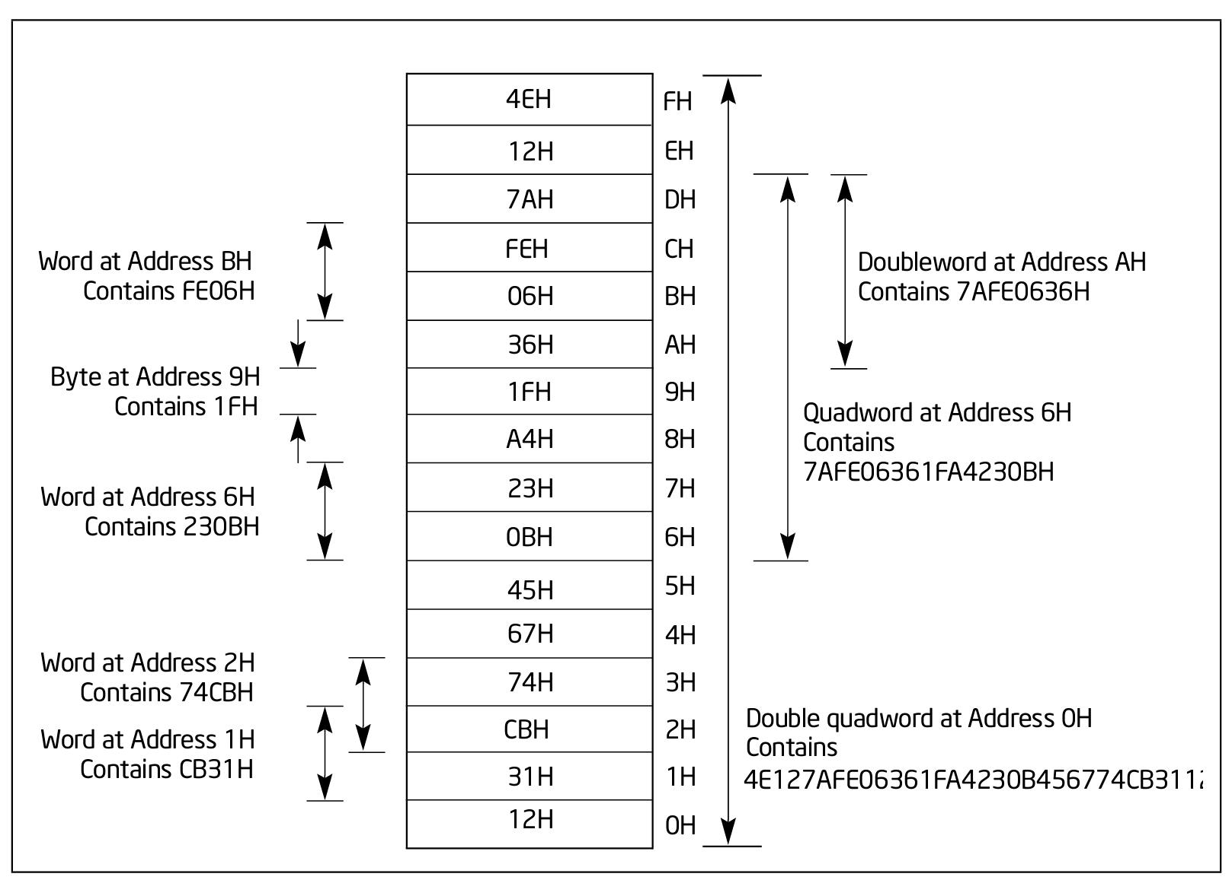
More examples from intel manual:
https://www.intel.com/content/www/us/en/develop/download/intel-64-and-ia-32-architectures-software-developers-manual-volume-1-basic-architecture.html

Slide 15
Registers
Some are “general purpose”, some have some “specific purpose”.
In practice, most registers can be manipulated similarly using the same instructions.
Reason of specific purpose:
some features are common in most programs, and so it is convenient to have special registers and instructions: for example stack pointers (rsp, rbp) which can used to maintain a stack in the memory, and serve as pointers for the “push” and “pop” instructions.
Special instructions can be encoded in less bytes: the “push” instruction always stores a value at the address given in rsp, that is
instruction: push rax sub rsp, 8
mov [rsp], rax
encoding: 50 48 83 ec 08
48 89 04 24

Slide 16
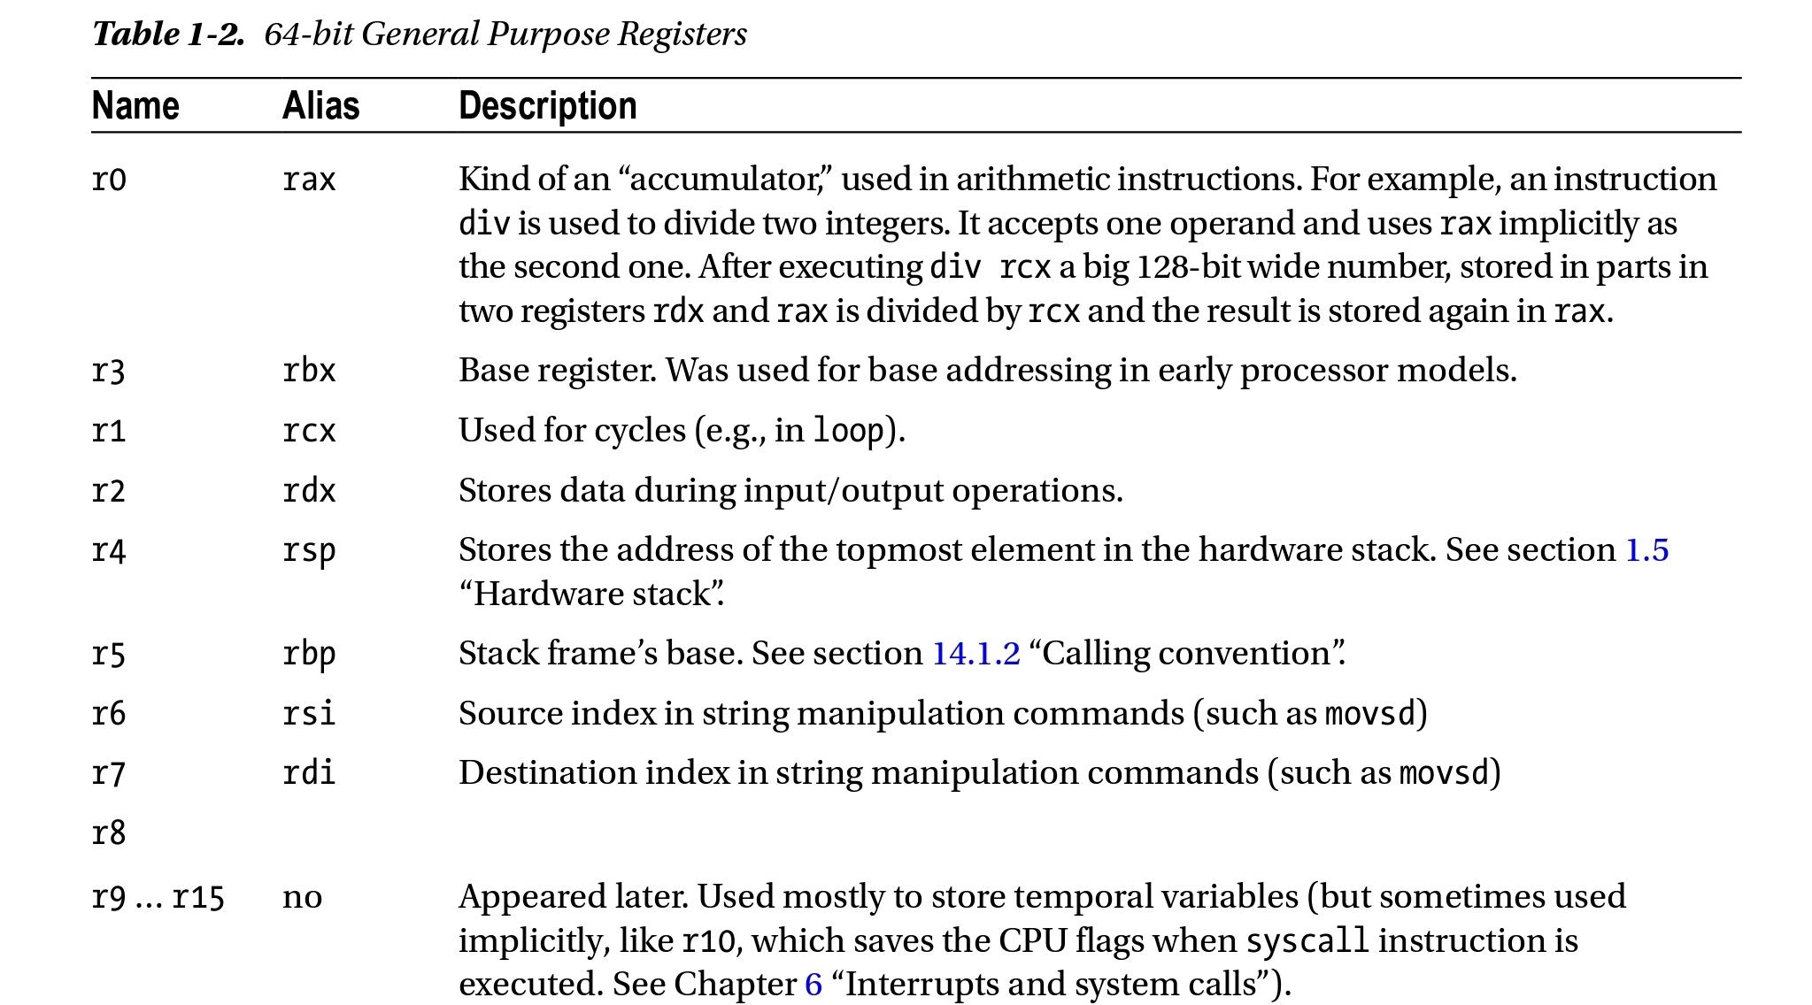
From: Low Level Programming C, Assembly and Program Execution on Intel 64 Architecture

Slide 17
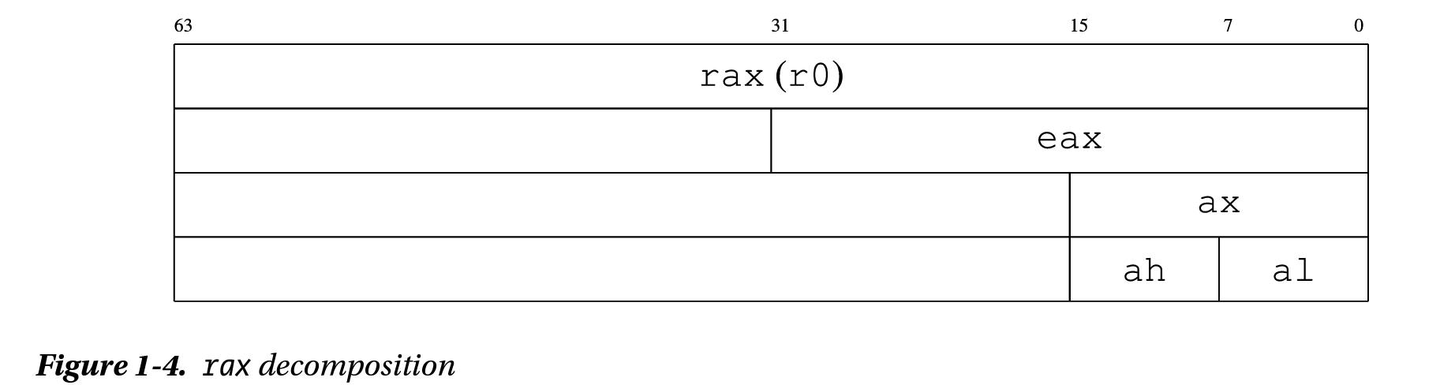
General purpose registers (GPRs)
Used as general operands in different instructions.
Some can have only a specific part of them as an operand.
Depends on the register and the instruction.

Slide 18
Special registers
rip and rflags registers.
Segment registers (CS, DS, SS, ES, FS, and GS).
x87 FPU registers (ST0 through ST7, status word, control word, tag word, data operand pointer, and instruction pointer).
MMX registers (MM0 through MM7).
XMM registers (XMM0 through XMM15) and the MXCSR register.
Control registers (CR0, CR2, CR3, CR4, and CR8) and system table pointer registers (GDTR, LDTR, IDTR, and task register)
Debug registers (DR0, DR1, DR2, DR3, DR6, and DR7).
MSR registers.
The registers used for basic program execution are the general purpose, rip and rflags (in unprivliged code).

Slide 19
rip (the register)
rip contains the address in the memory of the next instruction to be executed.
At each execution “step”, the instruction pointed to by rip will be executed, and rip will be incremented to rip + size in bytes of the executed instruction, so to point to the next instruction.
Note that different instructions are encoded with different lengths (in x86(-64)), and in fact this execution “step” is divided into suboperations of fetching the instruction at rip, decoding the operation and the operands from it, and then executing it. This operation is sometimes called “the fetch execute cycle”. We will talk about this later in the course.

Slide 20
rflags register
Contains flags which are updated by some instructions and could be used for conditional execution.
The result of executing the instruction at 26 (after executing the one at 23):
If rax=r8, rip will be set to 32, otherwise it will be set to 28
The lower 32 bits (of rflags) are referred to as “eflags”, the upper 32 bits are not used (“reserved”).
“eflags” is the name of the flags register in the x86 arch.

Slide 21
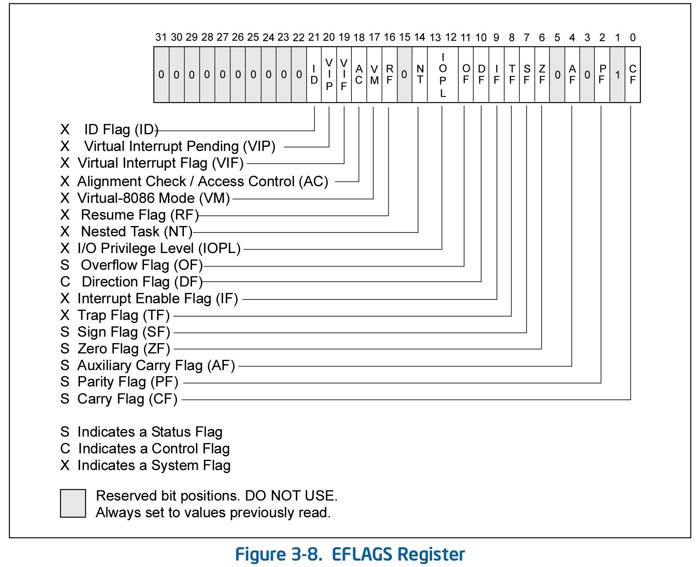

Slide 22
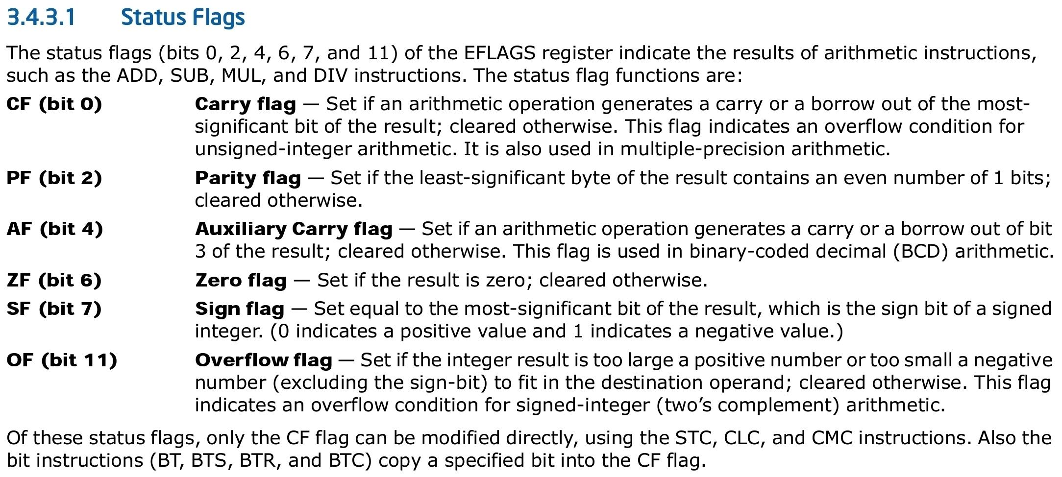

Slide 23
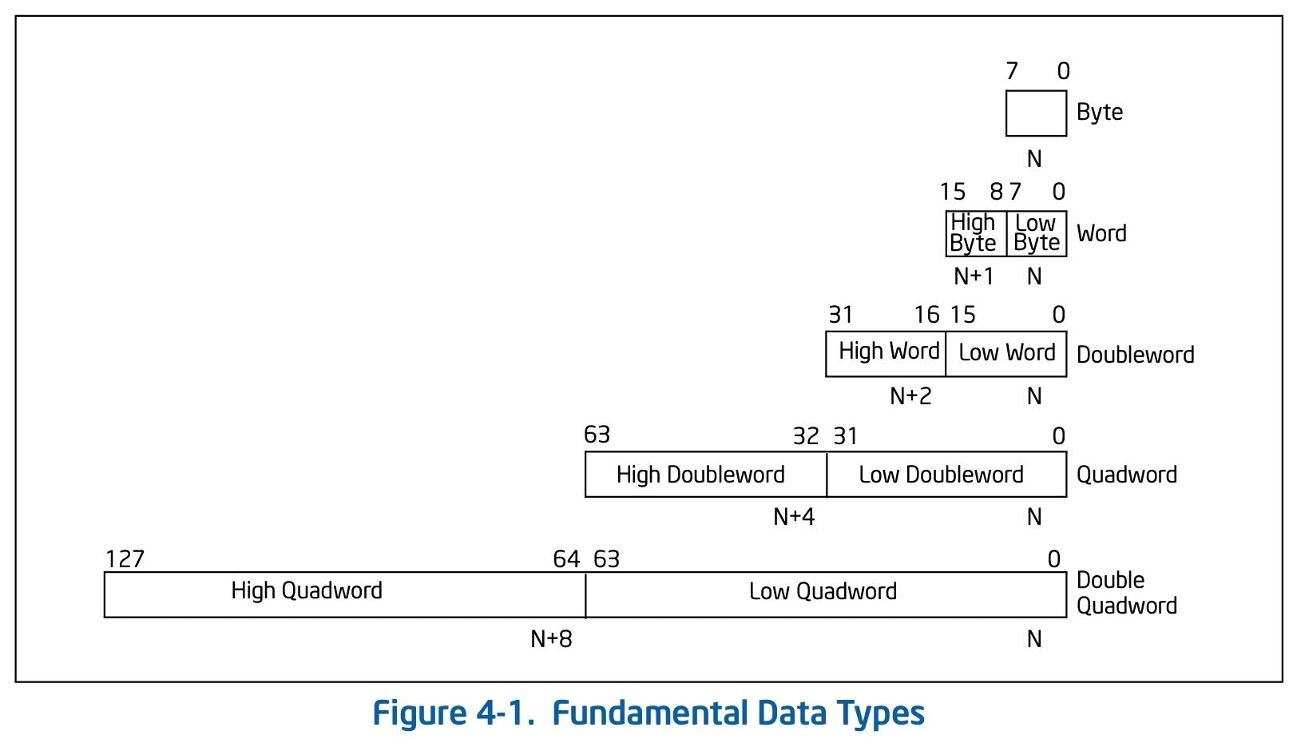
Instructions (preface)
Data types: We have mentioned bytes, words, etc.
A summed up notation table:
(from the Intel reference manual).
N marks the address in the memory.

Slide 24
Instruction operands
An instruction is an operation that operates on some operand(s).
Different types of operands are possible, depending on the instruction.
There are 3 common operand types (“addressing mode” of data):
Immediate operand:
Some instructions can have data encoded in the instruction itself as a source operand. These operands are called immediate operands (or simply immediates). For example:
mov rax, 0x3a4b is encoded as:
48 b8 4b 3a 00 00 00 00 00 00

Slide 25
Register operand:
Different registers can be source and destination operands for different instructions (depending on the instructions and the operands).
For example:
mov rax, rbx
push rcx
add rdx, 3.
Memory operands:
[memory address] = [segment selector + offset].
Usually (for code running in the same privilige in modern pcs) the segment selector is virtually not used (constant and implicit, equal to 0), and so effectively:
[memory address] = [offset].
Example of memory addressing instructions:
mov rax, [rdx]; // move into rax, the (qword) value stored in the memory location rdx
mov word [rbx + 8], 0x0009; // move into the word at memory location rbx+8, the
value 0x0009

Slide 26
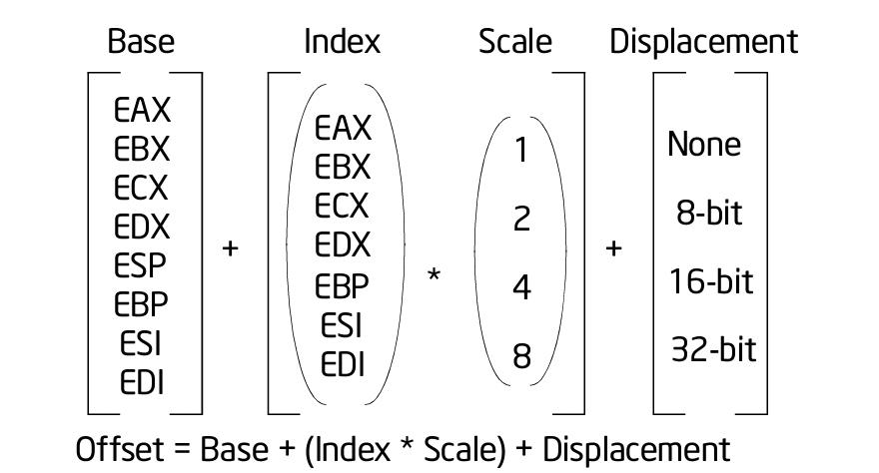
Addressing modes (i.e. format of ‘offset’, in 32 bit):
64 bit: Displacement: 8/16/32 bit value, Base: Value of a 64 bit GPR, Index: Value of a 64 bit GPR, Scale: 2/4/8 multiplied by index.
Another special supported addressing mode is the value of rip of next instruction + displacement

Slide 27
Note:
When using memory operands (that is storing or loading from some memory address), the operand size must sometimes be explicitly specified if it is not implied. Consider:
(V) mov eax, [rbx] - operand size is known to be 4 bytes (as the dst
operand eax, is of size 4).
(X) mov [rsp], 3 - operand size is ambiguous, and therefore needs to be
explicitely supplied.
(V) mov qword / dword / word / byte [rsp], 0x03
Some instructions have implicit register operands:
cmp rax, rbx - also updates the flags (rflags) implicitly.
mul rcx - has one operand, and always multiplies rax by this operand
and stores the 128 bit integer result in rdx and rax where the
high word is stored in rdx).
Most instructions have implicit segment register operands (which again are constant and disregarded by us for now).
Some (for example pop) affect several registers / operands implicitely.

Slide 28
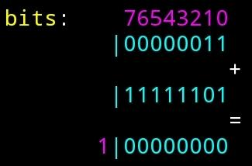
Signs
We wish to be able to preform signed operations.
The way that a signed integer is represented in the memory, is via the 2-complement notation, which uses the fact that unsigned calculations are preformed mod 2^{x} where x is the bitwidth of the integer.
An example of a calculation:
3 as a 1 byte (8 bit) signed integer: 0x03
-3 as a 1 byte (8 bit) signed integer: 0xFD
When we add them up and store
the result as a 1 byte integer:
3+(-3) = 0x03 + 0xFD =>
The resulting carry bit is dropped, as we are storing the result in an 8 bit integer, that is we get (0x03+0xfd) % 2⁸ = 0.

Slide 29
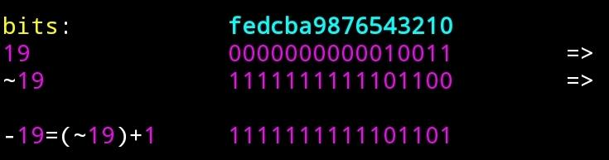
The binary representation of the number -x as an log(x)+1 bit integer is therefore:
-x = (~x)+1, where ~x (not x) is the number which in binary representation has 1 in bit j iff x has 0 in bit j.
That is, to get the binary representation of -x, we “flip” all of the bits in the binary representation of x, and add 1.
example -19 as a 2 byte integer:
19 as a 2 byte integer is given by 1*2⁰+1*2¹+0*2²+0*2³+1*2⁴+0*2⁵+0*.... =>

Slide 30
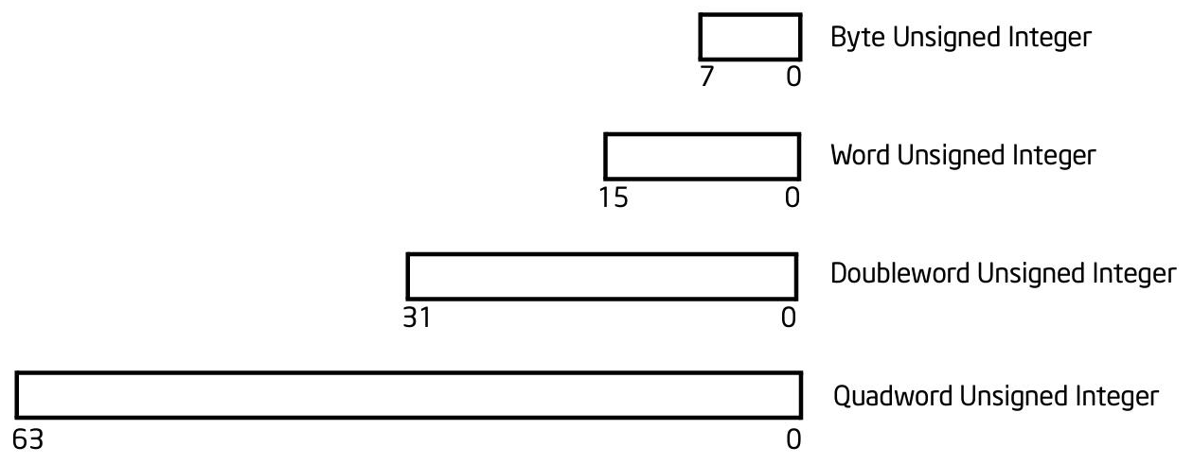
“Negative” numbers under this representation are considered the numbers with 1 at the most significant bit.
Notice that under this representation for a signed integer, we get that with k bytes (8k bits) we can represent the integers x where:
-2^{8k-1}<=x<=2^{8k-1}-1 (a total of 2^{8k-1}+1+2^{8k-1}-1=2^{8k} integers).
To summarize:
Unsigned integers:

Slide 31
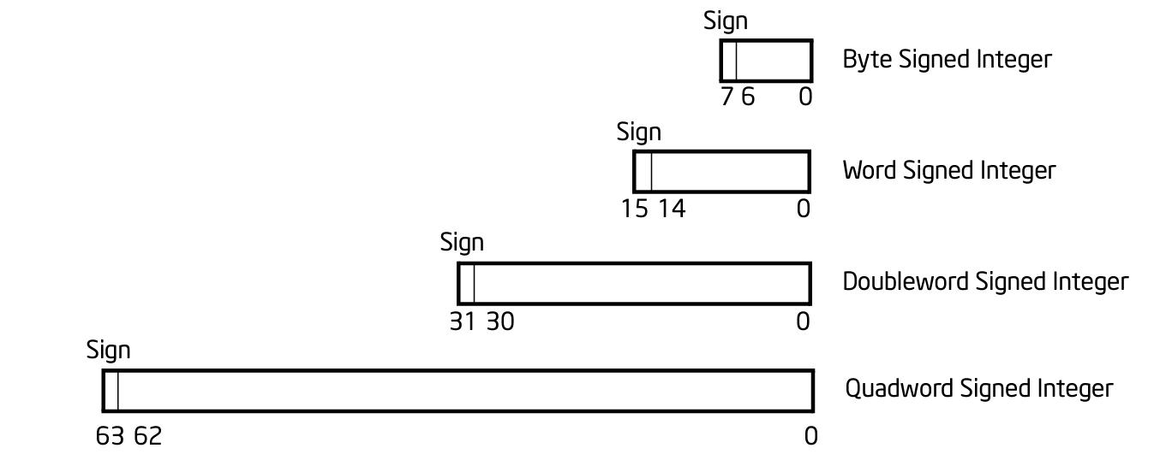
Signed integers:

Slide 32
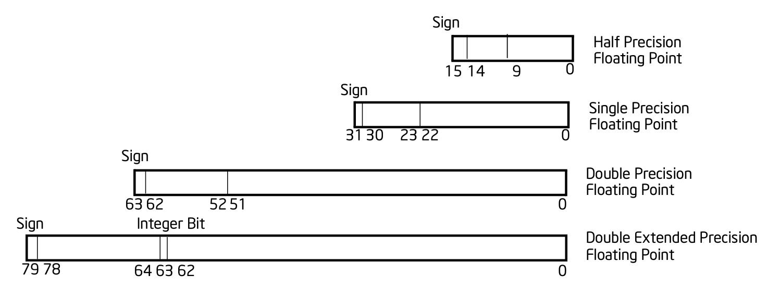
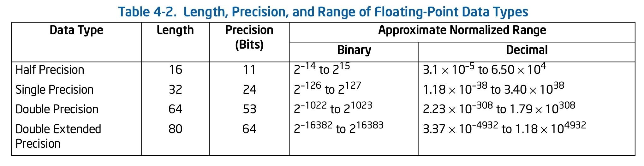
Floating point operands (less important to us)

Slide 33
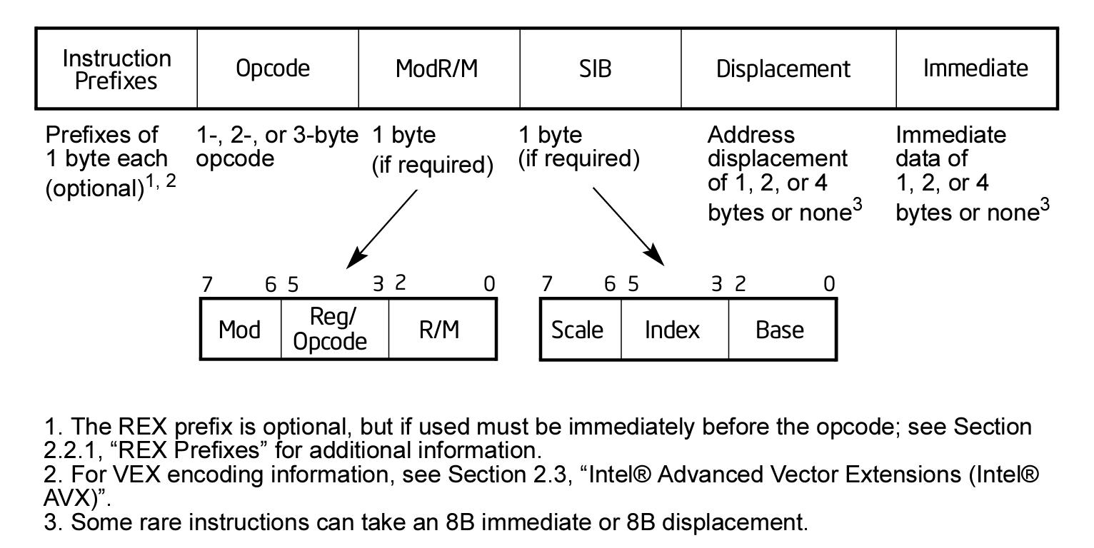
Finally, instructions
x86(-64) instruction encoding:

Slide 34
Instruction types:
• Basic instructions - mov, jmp
• Stack - push, pop
• ALU - add, mul, xor
• Floating point - faddp, fdiv
• SIMD (single instruction, multiple data)
• MMX, SSE
• String Operations
• Protection modes, interrupts, many more…
Instruction structure:
INSTR [operand_0, operand_1, ….]
Note: Many instructions affect the flags register implicitly.

Slide 35
Common types of instructions
Arithmetic Instructions (many affect the flags):
add / sub
inc / dec
mul / div / imul / idiv
and / or / xor / not
shl / shr (shift left / right)
cmp (affects the flags like the sub instruction but does not alter operands)
test (affects the flags like the and instruction but does not alter operands)
Load / Store Instructions:
mov
lea
push / pop
pusha(d) / popa(d)

Slide 36
Control flow (related) Instructions:
call
ret
enter / leave
jmp
j(z/e/nz/ne)
j(b/a/be/ae) (unsigned)
j(g/l/ge/le) (signed)
Misc instructions:
nop
sysenter / sysexit / syscall / sysret
cpuid, clflush
Privileged (lgdt, lidt, cli ….)

Slide 37
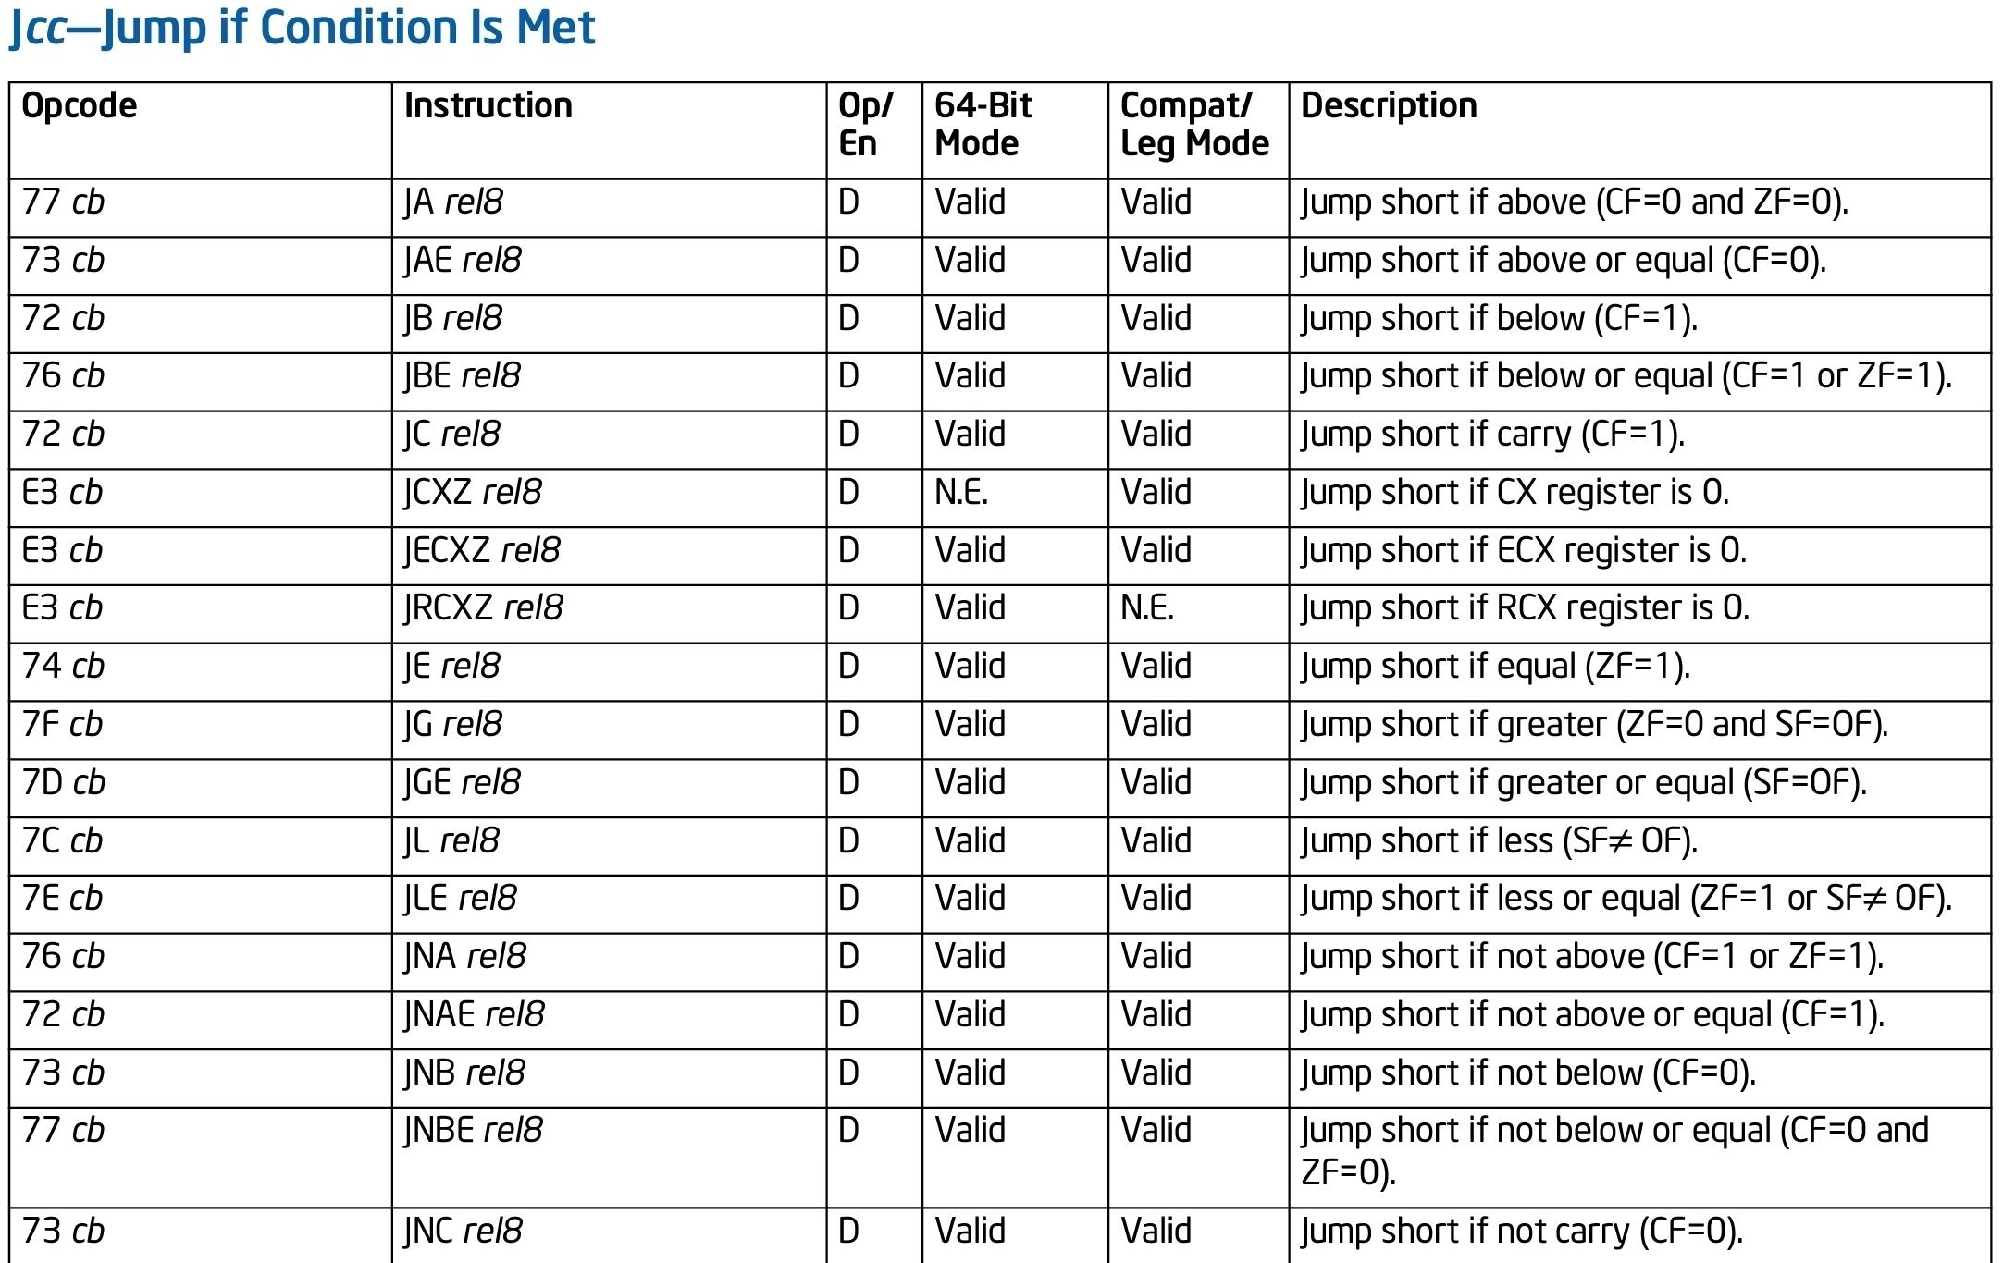

Slide 38
References (Many of the figures are taken from here):
Architecture:
https://www.intel.com/content/www/us/en/architecture-and-technology/64-ia-32-architectures-software-developer-vol-1-manual.html
Instruction set:
https://www.intel.com/content/dam/www/public/us/en/documents/manuals/64-ia-32-architectures-software-developer-instruction-set-reference-manual-325383.pdf

Slide 39
Code: examples and tips

